Slide 1
Data Structures and Its Applications

Slide 2
UNIT – I
Data Structures: Introduction, Difference between data type and data structure, Need of Data structure, Classification of Data structures, Linear vs. Non-linear Data Structures.
Types of Data Structures in Python: Built-in and User-defined data structures.
Static Linear Data Structure: Arrays- Characteristics of an Array, Applications of Arrays. Arrays vs. List.
Searching:
Linear Search, Binary search.
Sorting:
Merge Sort, Bubble Sort, Selection Sort and Quick Sort

Slide 3
Introduction
What is Data?
The quantities, characters or symbols on which operations are performed by a computer, which may be stored or transmitted in the form of electrical signal or recorded on magnetic, optical or mechanical recording media.
Data→Information ?
aymnemsiaryus ------------------Data
my name is surya -------Information(Processed Data)
To provide appropriate way to structure the data, Data Structures is required.

Slide 4
Introduction(contnd…)
What is Data Structure?
A data structure is a way of organizing and storing data in a computer so that it can be accessed and used efficiently.
The main idea behind using data structures is to minimize the time and space complexities.
An efficient data structure takes minimum memory space and requires minimum time to execute the data.

Slide 5
Introduction(contnd…)
Data Structures are the main part of many Computer Science Algorithms as they allow the programmers to manage the data in an effective way.
It plays a crucial role in improving the performance of a program or software, as the main objective of the software is to store and retrieve the user's data as fast as possible.

Slide 6
Need of Data Structure
As applications are becoming more complex and the amount of data is increasing every day,
which may lead to problems with
1.data searching,
2.processing speed,
3.multiple requests handling and many more.
Data Structures support different methods to organize, manage, and store data efficiently.
With the help of Data Structures, we can easily traverse the data items.

Slide 7
Need of Data Structure
Eg.
Student rollnumber in 20000 pages pdf.
Case:1: all the numbers are arranged at random.
Case:2: all the numbers are arranged in an ascending order

Slide 8
Need of Data Structure
Efficient data processing: Data structures provide a way to organize and store data in a way that allows for efficient retrieval, manipulation, and storage of data.
Memory management: Proper use of data structures can help to reduce memory usage and optimize the use of resources. For example, using dynamic arrays can allow for more efficient use of memory than using static arrays.

Slide 9
Need of Data Structure
3. Code reusability: Data structures can be used as building blocks in various algorithms and programs, making it easier to reuse code.
4. Abstraction: Data structures provide a level of abstraction that allows programmers to focus on the logical structure of the data and the operations that can be performed on it, rather than on the details of how the data is stored and manipulated.
5. Algorithm design: Many algorithms rely on specific data structures to operate efficiently. Understanding data structures is crucial for designing and implementing efficient algorithms.

Slide 10
Why should we learn Data Structures?
Data Structures and Algorithms are two of the key aspects of Computer Science.
Data Structures allow us to organize and store data, whereas Algorithms allow us to process that data meaningfully.
Learning Data Structures and Algorithms will help us become better Programmers.
We will be able to write code that is more effective and reliable.
We will also be able to solve problems more quickly and efficiently

Slide 11
Applications:
2D Arrays →image Processing, Sudoku, Chess.
Stack → redo, undo, browsing history, call history
Queue →Circular queue-switch bw apps,FCFS, printer que.
Linked list →previous page, next page (browser)
Double LL →music player(previous song, next song), gallery(prev.img,next img)
Graph →fb, linkedin, social networking sites(users),fb graph api, googles knowledge api, google maps, yahoo and apple maps uses graphs to show the shortest path using BFS algo.
Tree →Representation file structure in File explorer, auto suggestion, decision based ML.

Slide 12
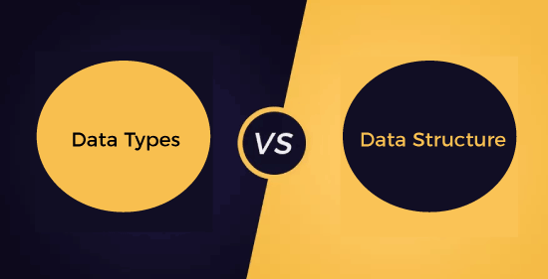

Slide 13
Data type | Data structure
A data type is a classification of data that defines the type of value that a variable can hold. In other words, it is a way to specify the data type that a variable can store. | A Data structure is a collection of data of similar or different data types. This collection of data can be represented using an object and can be used throughout the program.
The implementation of data type is known as an abstract implementation. | The implementation of data structure is known as a concrete implementation.
It can hold value but not data. Therefore, we can say that it is data-less. | It can hold multiple types of data within a single object.
In case of data type, a value can be assigned directly to the variables. | In the case of data structure, some operations are used to assign the data to the data structure object.
`There is no problem in the time complexity. | When we deal with a data structure object, time complexity plays an important role.
The examples of data type are int, float, char. | The examples of data structure are arrays, Linked lists, stack, queue, tree, graph.

Slide 14
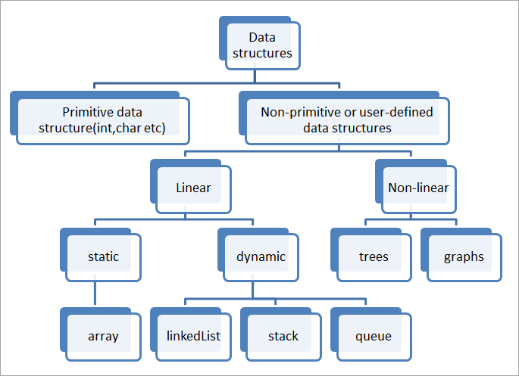
Classification of data structures

Slide 15
Classification of data structures
Data Structures are normally divided into two broad categories:
(1) Primitive Data Structures
(2) Non-Primitive Data Structures

Slide 16
Classification of data structures
Primitive Data Structures
Primitive Data Structures are the data structures consisting of the numbers and the characters that come in-built into programs.
These data structures can be manipulated or operated directly by machine-level instructions.
Ex: Integer, Float, Character, and Boolean etc.
These data types are also called Simple data types, as they contain characters that can't be divided further.

Slide 17
Classification of data structures
Non-Primitive Data Structures
Non-Primitive Data Structures are the complex data structures which are derived from Primitive Data Structures.
These data structures can't be manipulated or operated directly by machine-level instructions.
The focus of these data structures is on forming a set of data elements that is either homogeneous (same data type) or heterogeneous (different data types).

Slide 18
Non-Primitive Data Structures
The choice of data structure depends on the problem to be solved and the operations to be performed on the data.
Different data structures have different strengths and weaknesses and are suitable for different scenarios.
Understanding the different types of data structures and their characteristics is important for efficient algorithm design and implementation.

Slide 19
Non-Primitive Data Structures
Based on the structure and arrangement of data, data structures are divided into two sub-categories -
1. Linear Data Structures
2. Non-Linear Data Structures

Slide 20
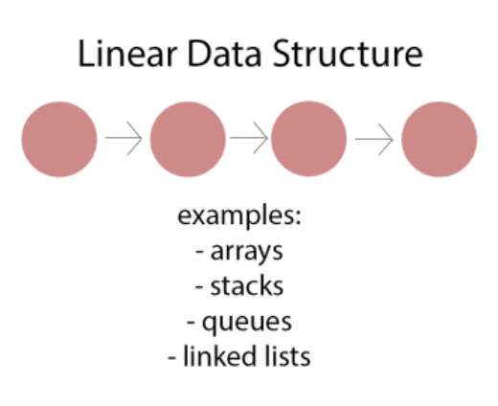
Non-Primitive Data Structures
Linear Data Structures:
A data structure that preserves a linear connection among its data elements is known as a Linear Data Structure.
The arrangement of the data is done linearly, where each element consists of unique successors and predecessors except the first and the last data element.
However, it is not necessarily true in the case of memory, as the arrangement may not be sequential.
Linear data structures are one-dimensional and can be traversed sequentially from the first to the last element.
Ex: Arrays, lists, stack, queue, etc.

Slide 21
Non-Primitive Data Structures
Based on memory allocation, the Linear Data Structures are further classified into two types:
1. Static Data Structure
2. Dynamic Data Structure

Slide 22
Linear Data Structures
Static Data Structures:
The data structures having a fixed size are known as Static Data Structures. The memory for these data structures is allocated at the compiler time, and their size cannot be changed by the user after being compiled;
However, the data stored in them can be altered. The Array is the best example of the Static Data Structure as they have a fixed size, and its data can be modified later.

Slide 23
Static Linear Data Structures
Arrays
An Array is a data structure used to collect multiple data elements of the same data type into one variable.
Instead of storing multiple values of the same data types in separate variable names, store all of them together into one variable.
Element − Each item stored in an array is called an element.
Index − Each location of an element in an array has a numerical index, which is used to identify the element.

Slide 24
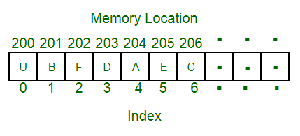
Static Linear Data Structures
Arrays
An Array is a data structure used to collect multiple data elements of the same data type into one variable.
Instead of storing multiple values of the same data types in separate variable names, store all of them together into one variable.
Example:

Slide 25
Static Linear Data Structures(Contd…)
Arrays can be classified into different types:
One-Dimensional Array: An Array with only one row of data elements is known as a One-Dimensional Array. It is stored in ascending storage location.
Two-Dimensional Array: An Array consisting of multiple rows and columns of data elements is called a Two-Dimensional Array. It is also known as a Matrix.
Multidimensional Array: We can define Multidimensional Array as an Array of Arrays. Multidimensional Arrays are not bounded to two indices or two dimensions as they can include as many indices are per the need.

Slide 26
Static Linear Data Structures(Contd…)
Array operations:
Traversal: Traverse through the elements of an array.
Insertion: Inserting a new element in an array.
Deletion: Deleting element from the array.
Searching: Search for an element in the array.
Sorting: Maintaining the order of elements in the array.

Slide 27
Static Linear Data Structures(Contd…)
Creating a Array:
Array in Python can be created by importing array module or Numpy module.
array(data_type, value_list) is used to create an array with data type and value list specified in its arguments.

Slide 28
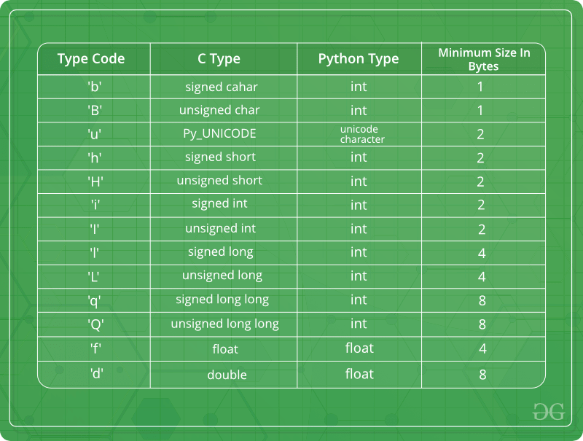

Slide 29
Common Operations:
Searching
Sorting
Insertion
Deletion
Updating

Slide 30
Introduction to Searching
Searching in data structure refers to the process of finding location LOC of an element in a list.
Various algorithms have been defined to find whether an element is present in the collection of items or not.

Slide 31
Searching Techniques
The most famous techniques of searching in data structures are:
Sequential Search
Binary Search

Slide 32
1. Sequential Search
In this type of search, all the elements of the list are traversed one by one to find if the element is present in the list or not.
One example of such an algorithm is a “linear search”.

Slide 33
Algorithm
Step 1: First, read the search element (Target element) in the array. Step 2: In the second step compare the search element with the first element in the array. Step 3: If both are matched, display “Target element is found” and terminate the Linear Search function. Step 4: If both are not matched, compare the search element with the next element in the array. Step 5: In this step, repeat steps 3 and 4 until the search (Target) element is compared with the last element of the array. Step 6 – If the last element in the list does not match, the Linear Search Function will be terminated, and the message “Element is not found” will be displayed.

Slide 34
Example:
Suppose ARR is an array of n elements, and we need to find location LOC of element ITEM in ARR.
For this, LOC is assigned to -1, which indicates that ITEM is not present in ARR.
While comparing ITEM with data at each ARR location, and once ITEM == ARR[N], LOC is updated with location N+1. Hence we found the ITEM in ARR.

Slide 35
2. Binary Search
This is a technique to search an element in the list using the divide and conquer technique.
This type of technique is used in the case of sorted lists.
Instead of searching an element one by one in the list, it directly goes to the middle element of the list, divides the array into 2 parts, and decides element lies in which sub-array the element exists.

Slide 36
Suppose ARR is an array with sorted n number of elements present in increasing order.
With every step of this algorithm, the searching is confined within BEG and END, which are the beginning and ending index of sub-arrays.
The index MID defines the middle index of the array where,
MID = INT(beg + end )/2

Slide 37
BSEARCH(ARR, LB, UB)
Here, ARR is a sorted list of elements, with LB and UB are lower and upper bounds for the array.
ITEM needs to be searched in the array and algorithm returns location / index at which ITEM is present else return -1/None.

Slide 38
Algorithm
1. Set BEG = LB, END = UB MID = INT([BEG+END]/2) 2. Repeat step 3, 4 and 5 while BEG<=END 3. MID = INT([BEG+END]/2)
4. IF ITEM< ARR[MID] then: Set END = MID-1 Else: Set BEG = MID+1 5. IF ARR[MID] = ITEM then: return MID 6. Exit.

Slide 39
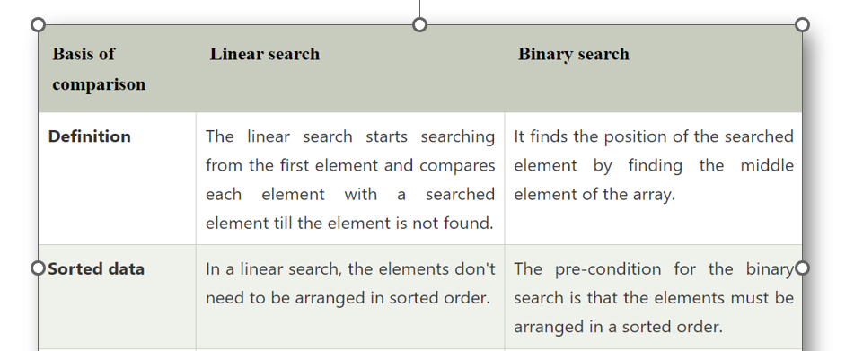
Difference between Linear Search and Binary Search

Slide 40
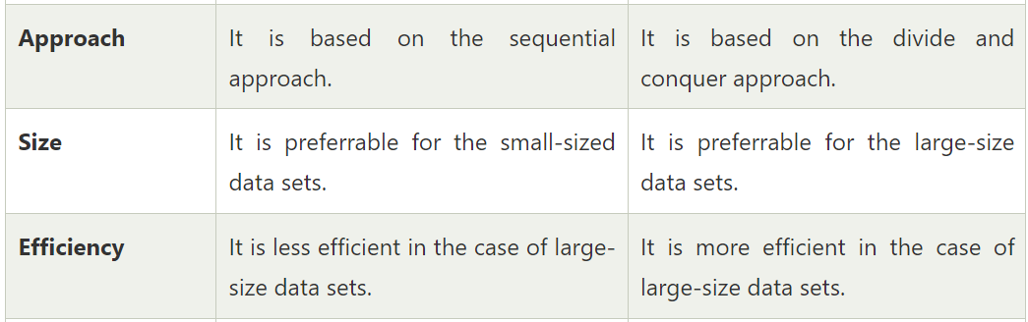
Difference between Linear Search and Binary Search

Slide 41
Sorting
Sorting is the process of arranging items in a specific order or sequence. It is nothing but storage of data in sorted order.
Sorting can be done in ascending and descending order.
It arranges the data in a sequence which makes searching easier.
Example:
Contact List in Mobile Phone, Search engines, E-commerce, Financial markets, Image processing, Database management, Logistics, Social media.

Slide 42
Sorting Techniques
Sorting technique depends on the situation.
It depends on two parameters.
1. Execution time of program that means time taken for execution of program.
2. Space that means space taken by the program.
Sorting techniques are differentiated by their efficiency and space requirements.

Slide 43
Sorting Techniques
Sorting can be performed using several techniques or methods, as follows:
Bubble Sort
2. Selection Sort
3. Merge Sort
4. Quick Sort

Slide 44

1.Bubble Sort
Bubble Sort is the simplest sorting algorithm that works by repeatedly swapping the adjacent elements if they are not in the intended order.
It is called bubble sort because the movement of array elements is just like the movement of air bubbles in the water. Bubbles in water rise up to the surface; similarly, the array elements in bubble sort move to the end in each iteration.
It comprises of comparing each element to its adjacent element and replace them accordingly.
This is an inefficient sort as it has to loop through all the elements multiple times.

Slide 45
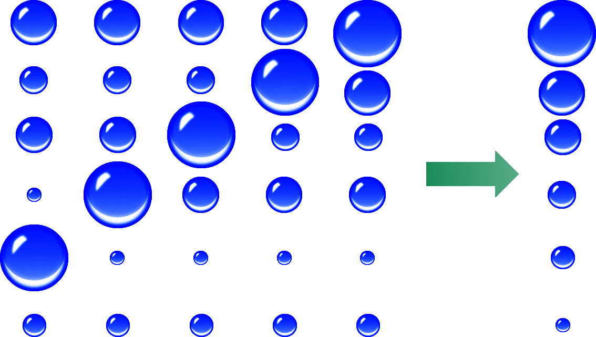
1.Bubble Sort
After multiple iterations

Slide 46
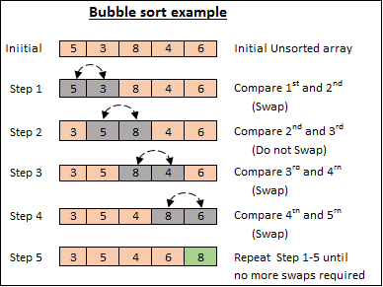
1.Bubble Sort (Algorithm)

Slide 47
1.Bubble Sort (Algorithm)
It compares one pair at a time and swaps if the first element is greater than the second element; otherwise, move further to the next pair of elements for comparison.
If the first value exceeds the second, their positions will be switched or exchanged, means do swapping.
If not, no swapping is carried out.
This process is repeated until all the values in a list have been compared and swapped if necessary.
Each iteration is usually called a pass.
The number of passes in a bubble sort is equal to the number of elements in a list minus one.

Slide 48
1.Bubble Sort (Algorithm)
Advantages:
Bubble sort is easy to understand and implement.
It does not require any additional memory space.
It’s adaptability to different types of data.
Disadvantages:
It is not efficient for large data sets, because it requires multiple passes through the data.

Slide 49
2. Merge Sort
Merge sort is a sorting algorithm that works by dividing an array into smaller subarrays, sorting each subarray, and then merging the sorted subarrays back together to form the final sorted array.
In simple terms, we can say that the process of merge sort is to divide the array into two halves, sort each half, and then merge the sorted halves back together.
This process is repeated until the entire array is sorted.

Slide 50
Algorithm
step 1: start
step 2: declare array and left, right, mid variable
step 3: perform merge function.
Find the middle point to divide the array into two halves
mid= (left+right)/2
Call mergeSort for first half
mergesort(array, left, mid)
Call mergeSort for second half
mergesort(array, mid+1, right)
Merge the two halves sorted in steps 2 and 3
merge(array, left, mid, right)
step 4: Stop

Slide 51
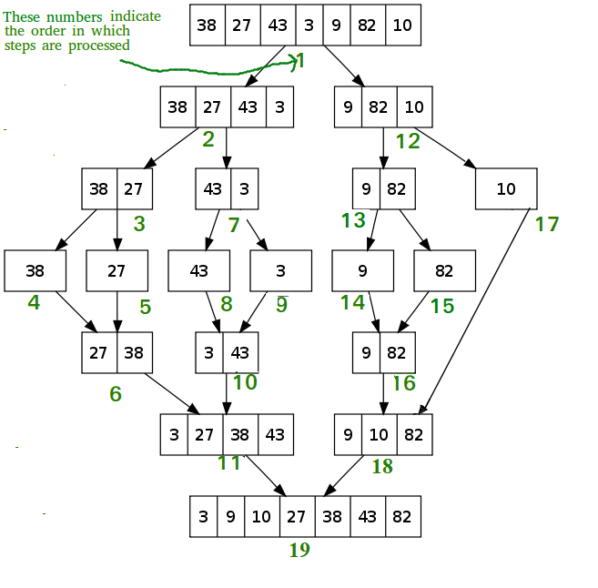
Merge Sort Step-by-step example:

Slide 52
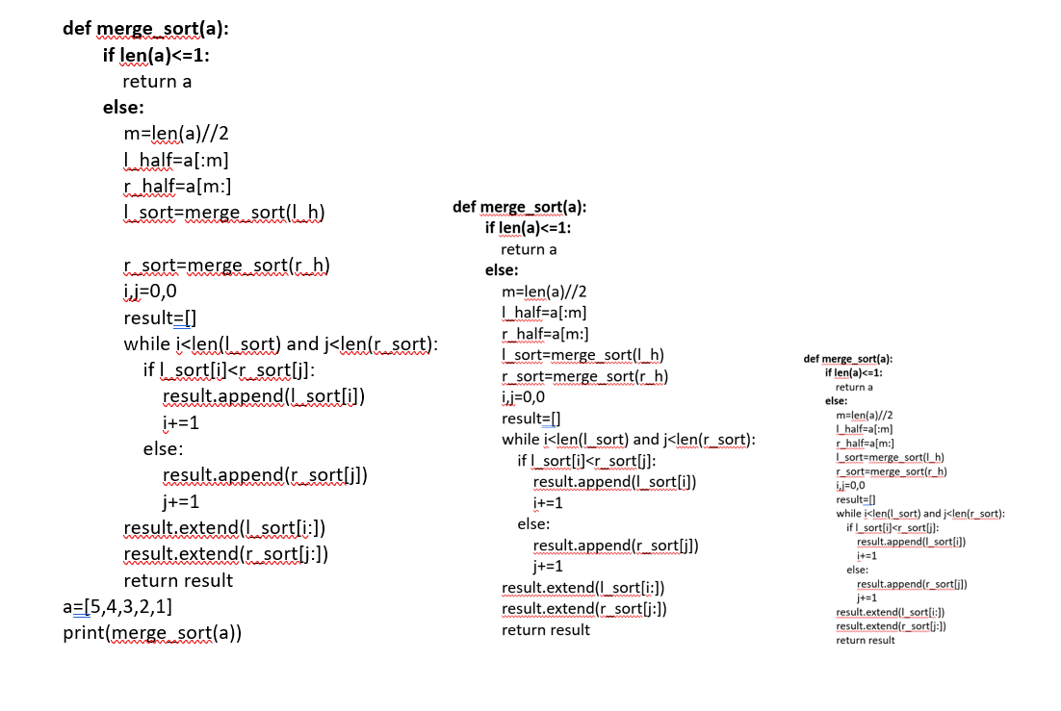
5 4 1 3 2
5 4
1 3 2
([5 , 4])
[4 5]
[1 3 2]
[1 3 2]
[5]
[4]
[5]
[4]
4
4,5
4,5
4,5

Slide 54
Advantages of Merge Sort:
Stability: Merge sort is a stable sorting algorithm, which means it maintains the relative order of equal elements in the input array.
Parallelizable: Merge sort is a naturally parallelizable algorithm, which means it can be easily parallelized to take advantage of multiple processors or threads. This makes it useful for high-performance computing applications.
Versatility: Merge sort can be used to sort a wide range of data types, including integers, floating-point numbers, and strings.
Adaptability: Merge sort can be adapted to handle different input distributions, such as partially sorted, nearly sorted, or completely unsorted data. This makes it useful in a variety of real-world applications

Slide 55
Disadvantages of Merge Sort:
Space complexity: Merge sort requires additional memory to store the merged sub-arrays during the sorting process. This can be a disadvantage in applications with limited memory resources.
Recursive algorithm: Merge sort is a recursive algorithm, which can result in a large number of function calls and stack usage for very large datasets. This can cause stack overflow errors or other performance issues.
Not in-place: Merge sort is not an in-place sorting algorithm, which means it requires additional memory to store the sorted data. This can be a disadvantage in applications where memory usage is a concern.
Complexity of implementation: Merge sort can be more complex to implement than some other sorting algorithms, particularly for developers who are not familiar with recursive algorithms or the concept of merging sorted sub-arrays.

Slide 56
3. Selection Sort
The selection sort algorithm sorts an array by repeatedly finding the minimum element (considering ascending order) from unsorted part and putting it at the beginning.
The algorithm maintains two subarrays in a given array.
1) The subarray which is already sorted.
2) Remaining subarray which is unsorted.
In every iteration of selection sort, the minimum element (considering ascending order) from the unsorted subarray is picked and moved to the sorted subarray.

Slide 57




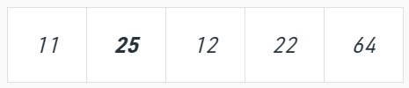
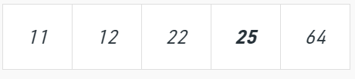

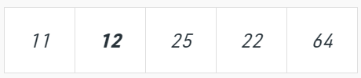
Example:
64
25
12
22
11

Slide 58
Algorithm
Get the length of the array/list.
First, we set the first element as minimum element (at index 0).
Now compare this minimum with the elements in the list that exists between index 1 and the index of the last element.
When an element less than the set minimum has been found, it is exchanged with the data found at index 0.
Repeat this process for all the other elements, until the entire array/list is sorted.

Slide 59
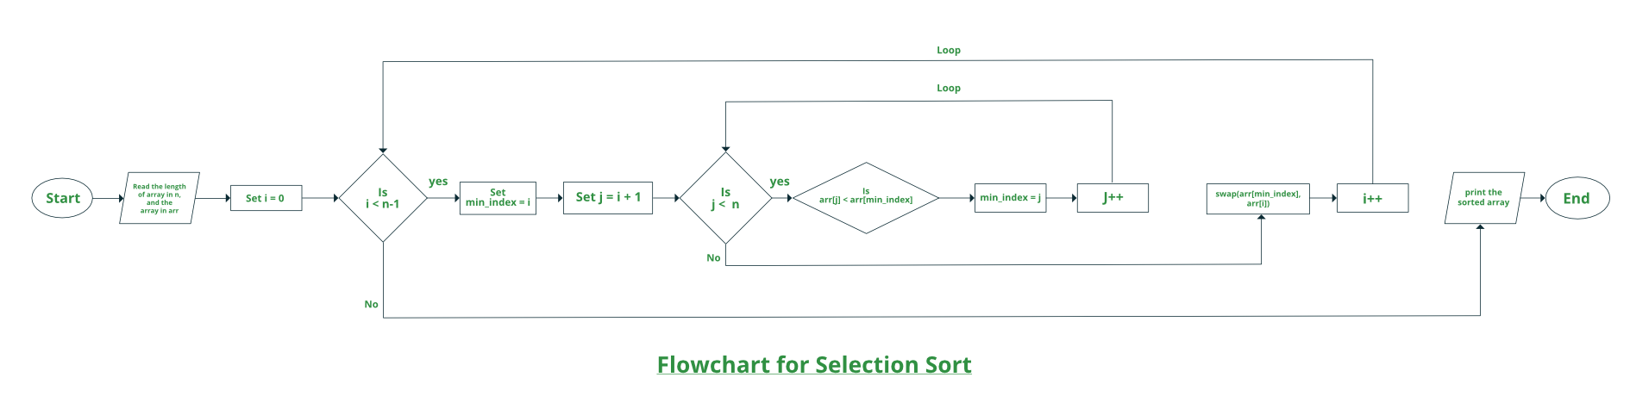

Slide 60
Program:
def selection_sort(arr):
n = len(arr)
for i in range(n):
# Find the minimum element in the unsorted part
min_index = i
for j in range(i+1, n):
if arr[j] < arr[min_index]:
min_index = j
# Swap the minimum element with the first element of the unsorted part
arr[i], arr[min_index] = arr[min_index], arr[i]
return arr
arr = [64, 25, 12, 22, 11]
print(selection_sort(arr))

Slide 61
Advantages of Selection Sort Algorithm:
Simple and easy to understand.
Works well with small datasets.
It is adaptable to various types of data types.
Selection sort is an in-place sorting algorithm, which means it does not require any additional memory to sort the list.
It is easy to modify to sort in ascending or descending order.
It can be easily implemented in hardware, making it suitable for real-time applications.

Slide 62
Disadvantages of the Selection Sort Algorithm:
Does not work well on large datasets.
The selection sort algorithm needs to iterate over the list multiple times, thus it can lead to an unbalanced branch.
It is not a parallelizable algorithm, meaning that it cannot be easily split up to be run on multiple processors or cores.

Slide 63
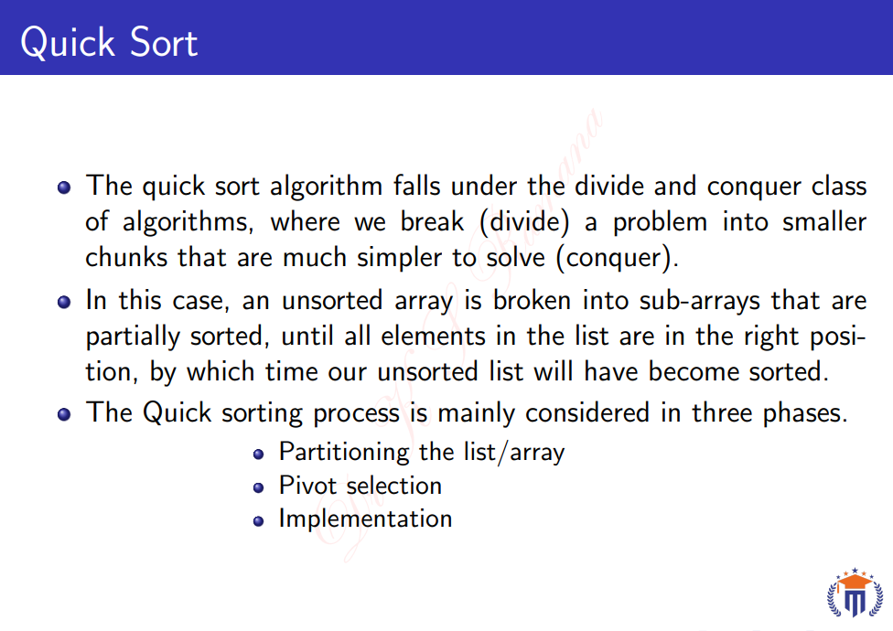

Slide 64
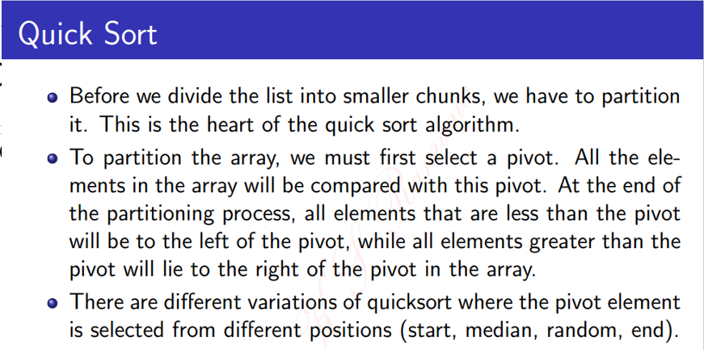

Slide 65
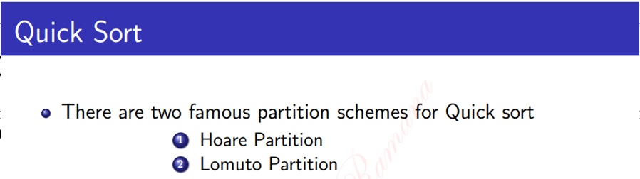

Slide 66
Quick Sort Algorithm
Step 1 − Make the Middle index value as pivot
Step 2 − partition the array using pivot value
Step 3 – At the end of partition, all the elements which are less than pivot will be to the left of the pivot and greater to be in the right side of pivot element.
Step 3 − quicksort left partition recursively
Step 4 − quicksort right partition recursively

Slide 67
Quick Sort Pivot Algorithm
Step 1 − Choose the middle index value as pivot
Step 2 − Take two variables to point left and right of the list excluding pivot.
Step 3 − left points to the low index
Step 4 − right points to the high index
Step 5 − while value at left is less than pivot move right
Step 6 − while value at right is greater than pivot move left
Step 7 − if both step 5 and step 6 does not match swap left and right
Step 8 − if left ≥ right, the point where they met is new pivot

Slide 68
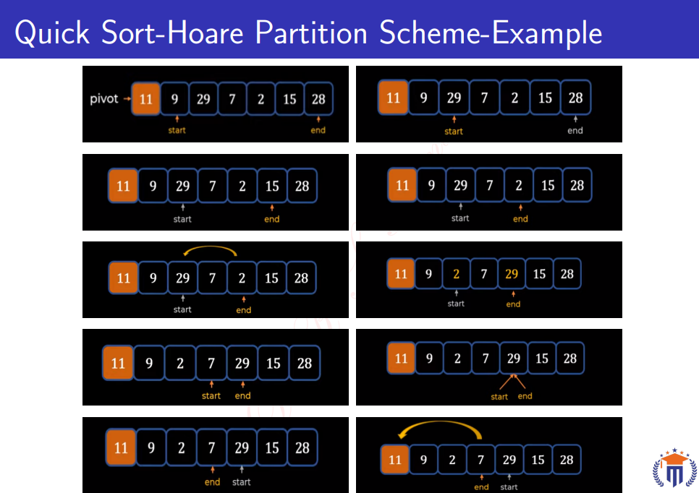

Slide 69
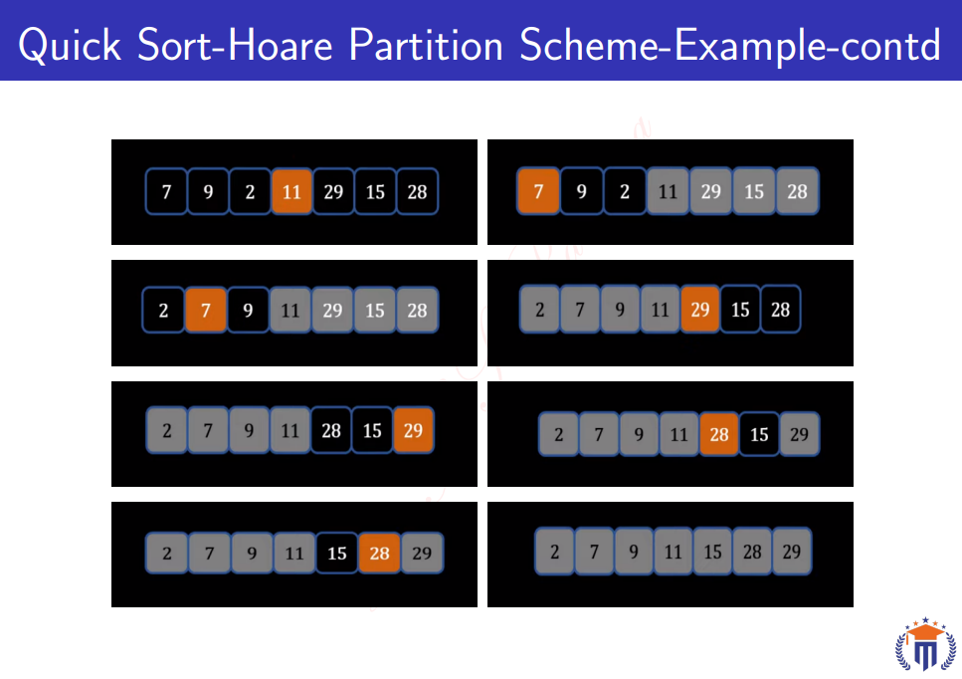

Slide 70
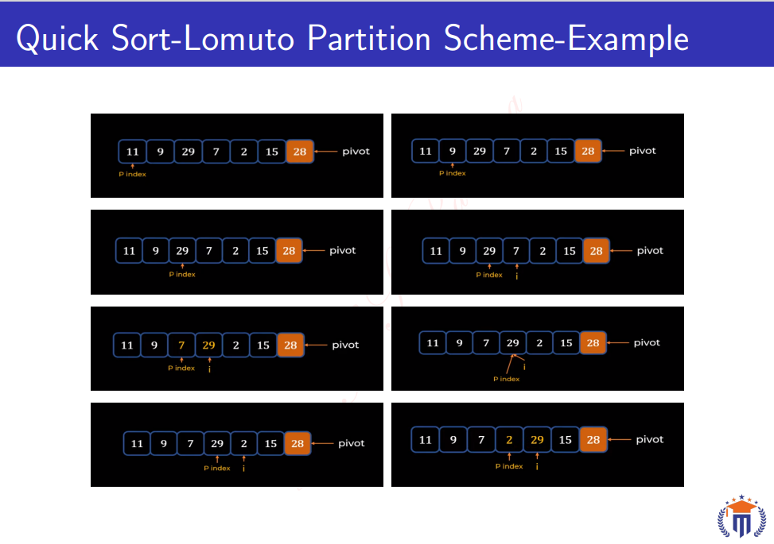

Slide 71
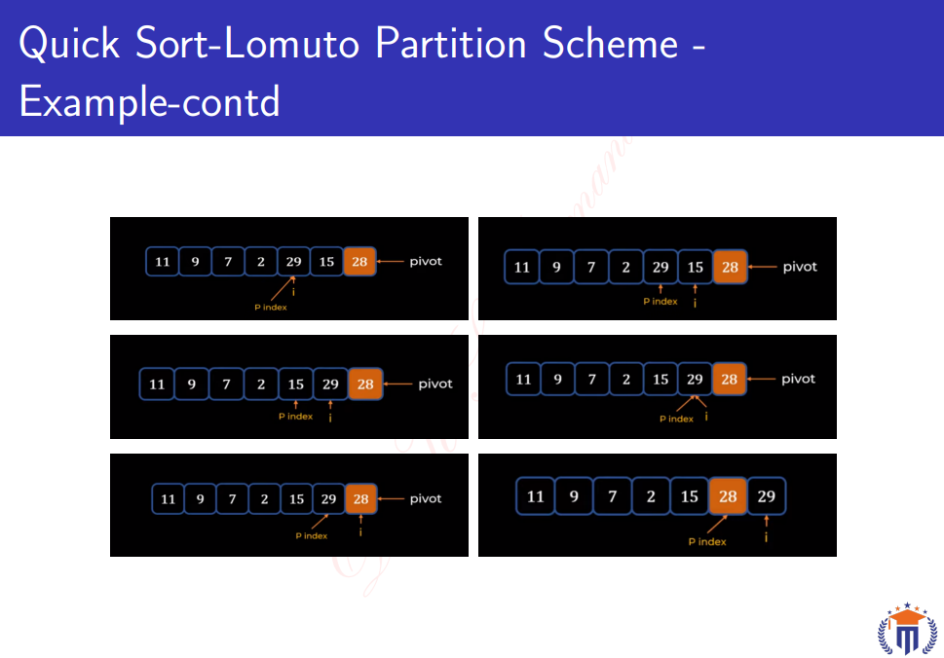

Slide 72
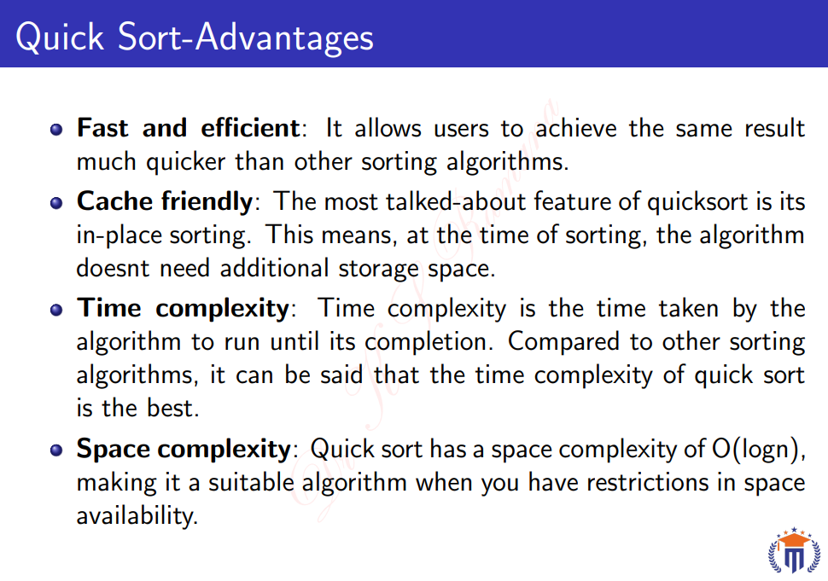

Slide 73
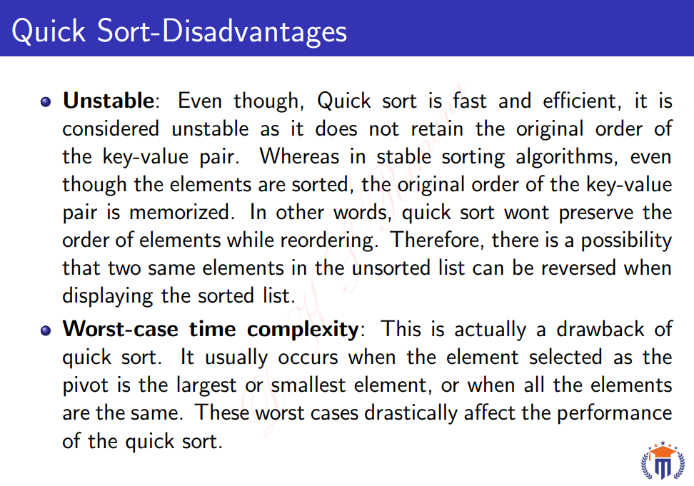

Slide 74
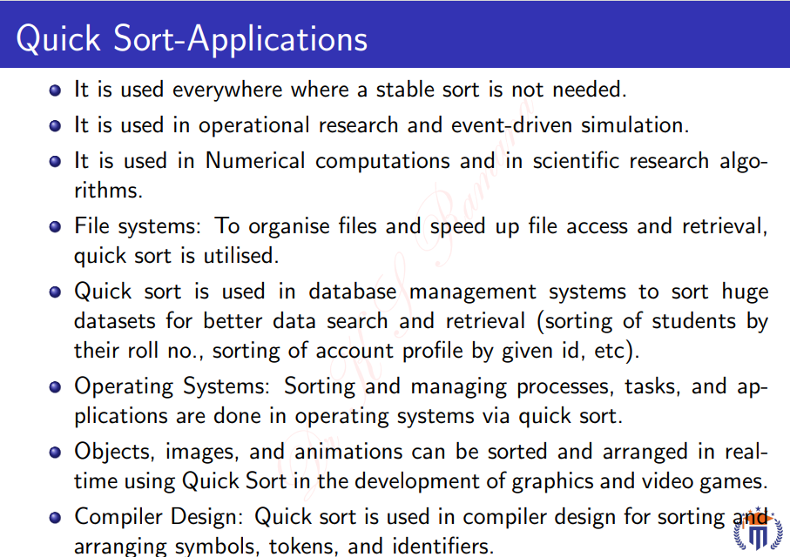

Slide 75
